Slide 1
Descriptive Statistics
[Measures of Symmetry]
Dr Parmila
Assistant Professor of Commerce
Kanya Mahavidyalaya Kharkhoda

Slide 2
Descriptive Statistics
Measures of Central Tendency
Measures of Location
Measures of Dispersion
Measures of Symmetry
Measures of Kurtosis

Slide 3
Symmetric Distribution
A distribution is symmetric if it can be folded along the vertical axis so that the two sides coincide.
If the distribution is symmetric, the mean, the median, and the mode are equal and are located at the same position along the horizontal axis

Slide 4
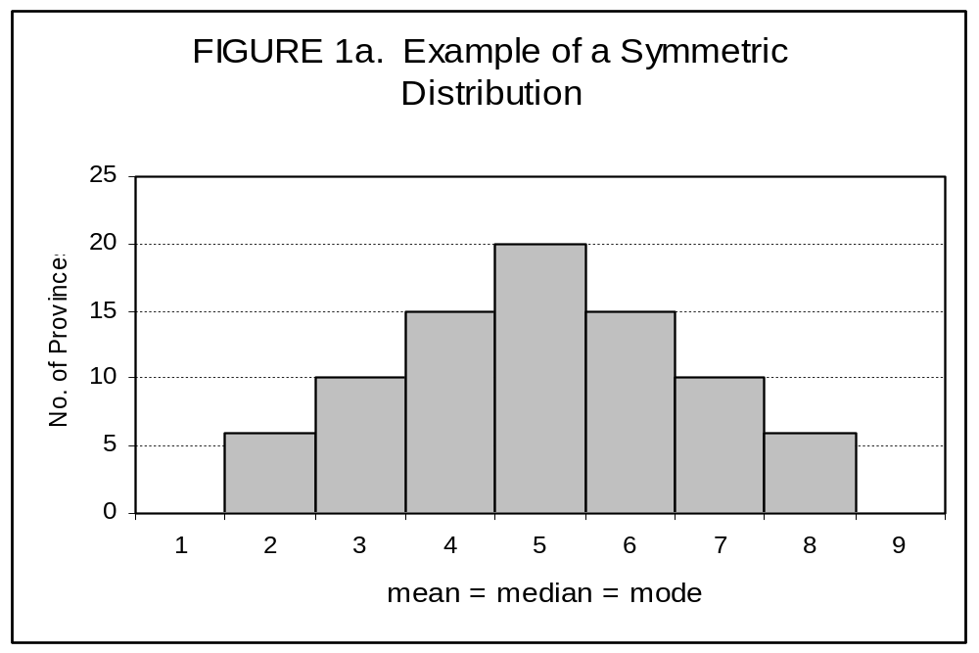
Example of a Symmetric Distribution

Slide 5
Meaning of Skewness
The term skewness means lack of symmetry in a frequency distribution
Skewness denotes the degree of departure of a distribution from symmetry and reveals the direction of scatterness of the items.
Skewness tells us about the asymmetry of the frequency distribution.

Slide 6
Measures of Symmetry
Skewness
  Symmetric distribution
  Positively skewed distribution
  Negatively skewed distribution

Slide 7
Skewness and frequency distribution
if the two sides do not coincide, distribution is said to be asymmetric.
a distribution that is asymmetric with respect to a vertical axis is said to be skewed.

Slide 8
Two Types of Skewness
Positive Skewed Distribution
Negatively Skewed Distribution

Slide 9
Positively skewed distribution
If the longer tail of the frequency curve of distribution lies to the right of the central point, it is called a positively skewed distribution.

Slide 10
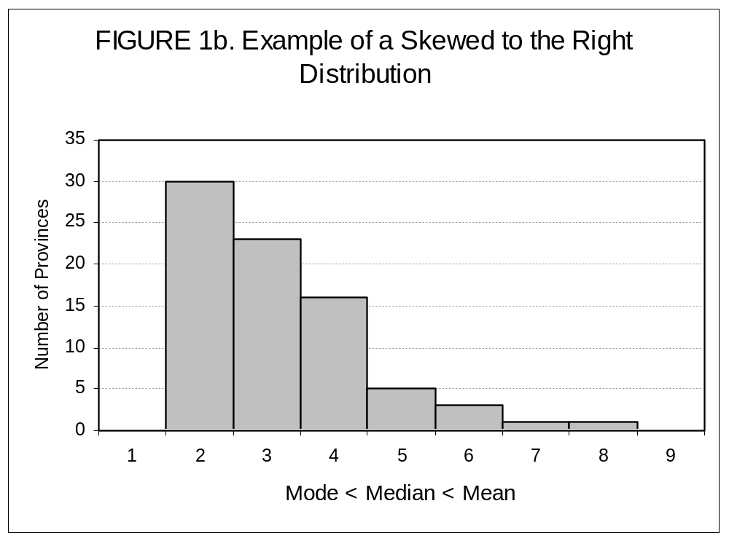
Positively Skewed Distribution

Slide 11
Negatively skewed distribution
If the longer tail of the frequency curve of distribution lies to the left of the central point, it is called a negatively skewed distribution.

Slide 12
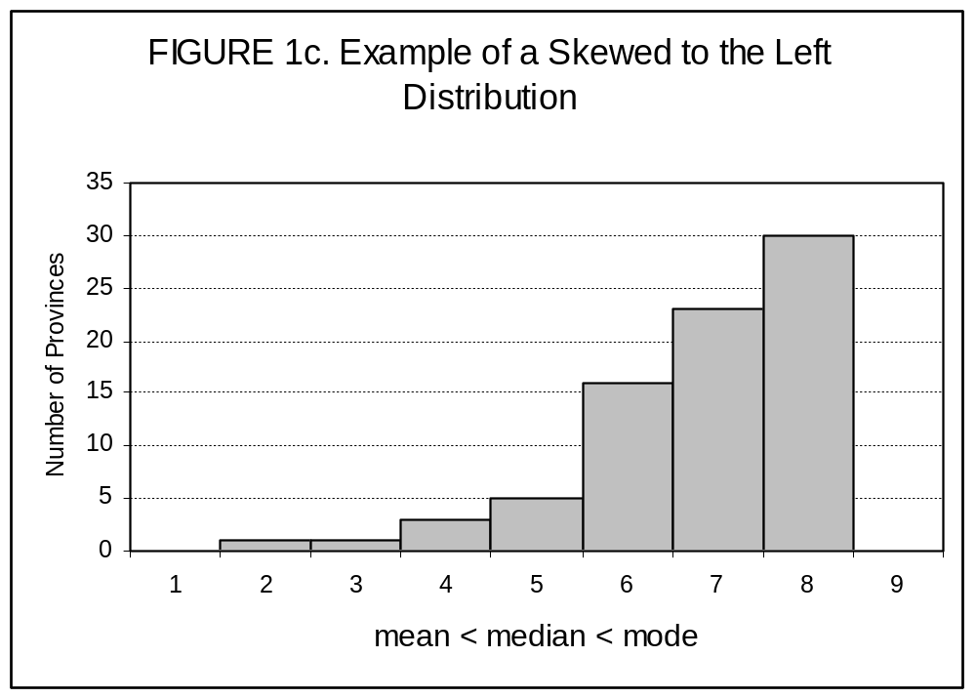
Two Types of Skewness

Slide 13
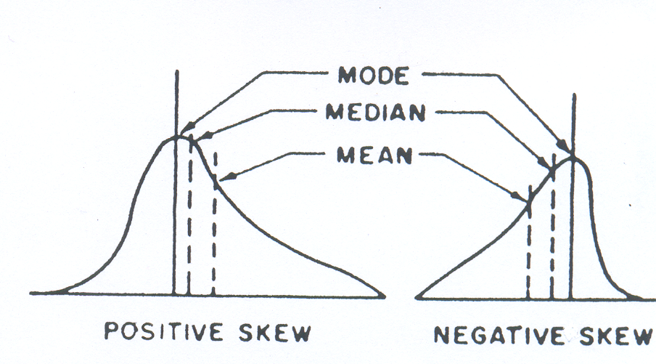
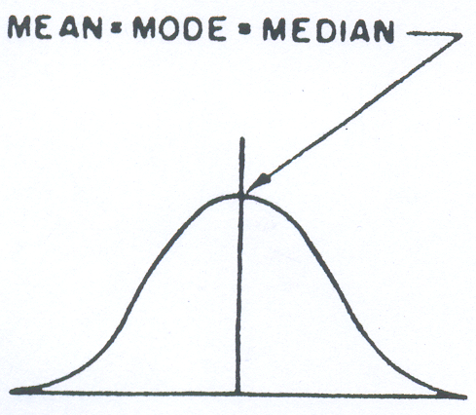
Measures of Skewness
If Mean > Mode, the skewness is positive.
If Mean < Mode, the skewness is negative.
If Mean = Mode, the skewness is zero.

Slide 14
Measures of skewness

Slide 15
Thanks

